Slide 1




Innovative Embedded Solutions for a Smarter Future
FPGA Production Line Introduction
phutruong@ontech.com.vn
(+84) 902 034 191
https://onekiwi.com.vn/
https://onekiwi.ai

Slide 2
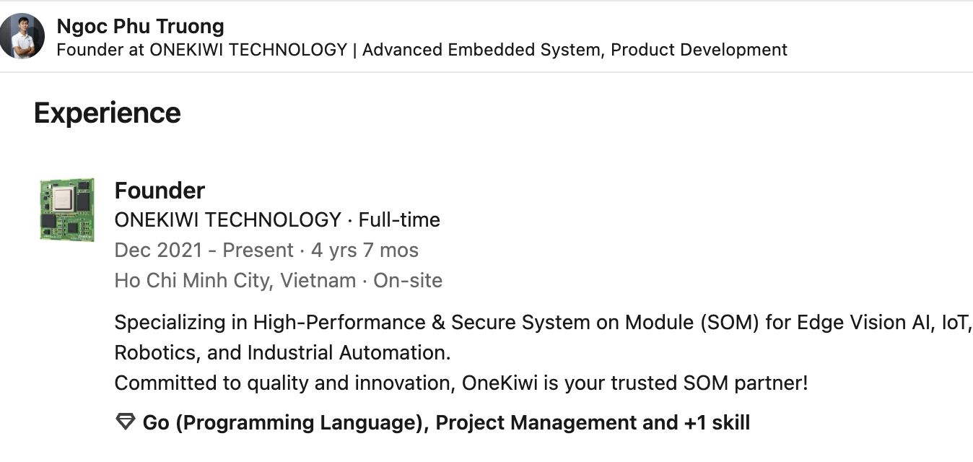

About me
LinkedIn Profile

Slide 3
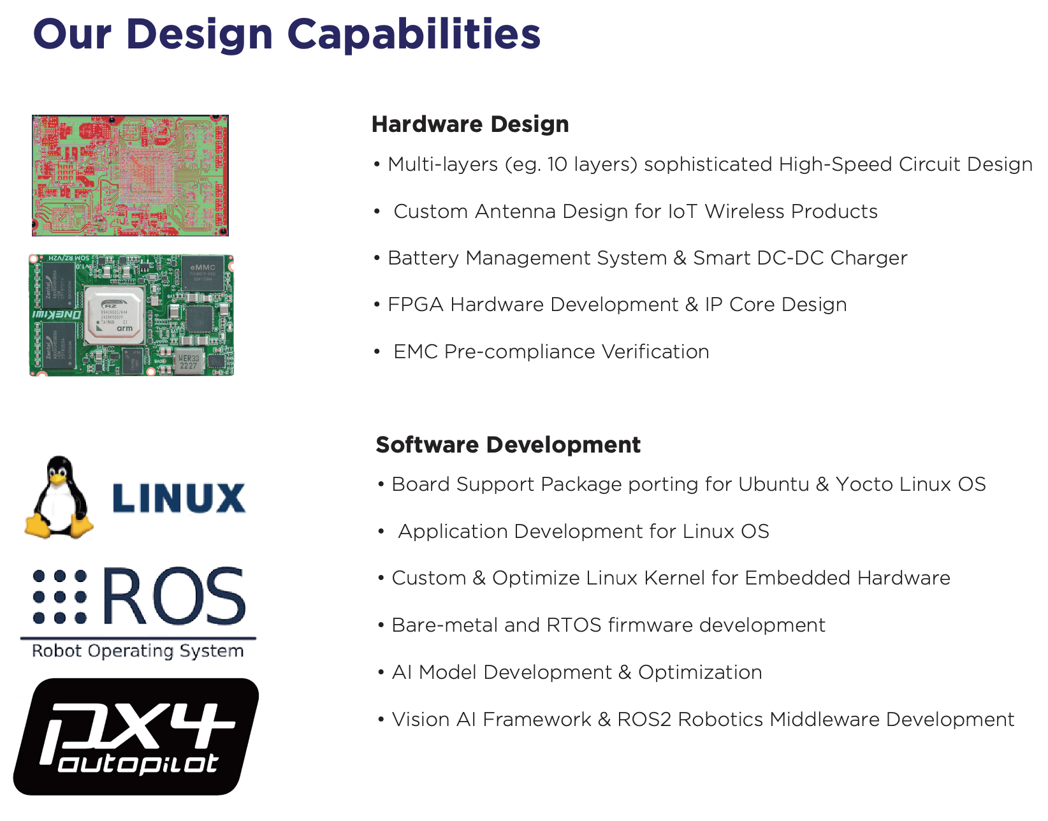
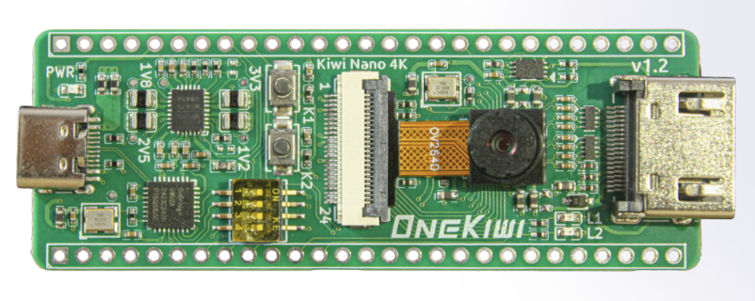
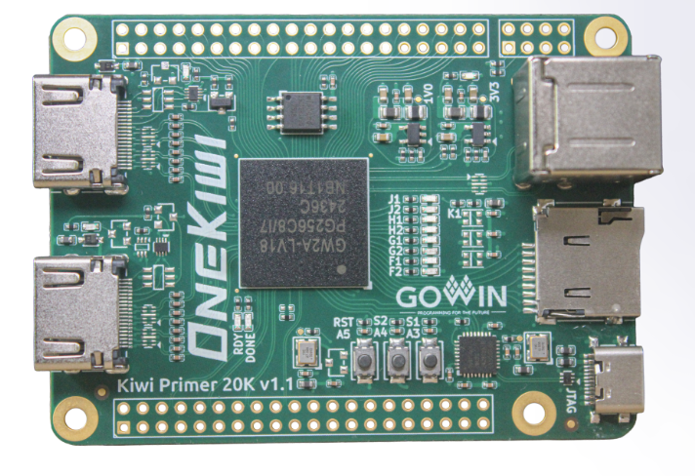
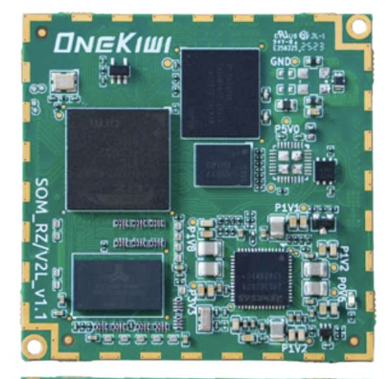
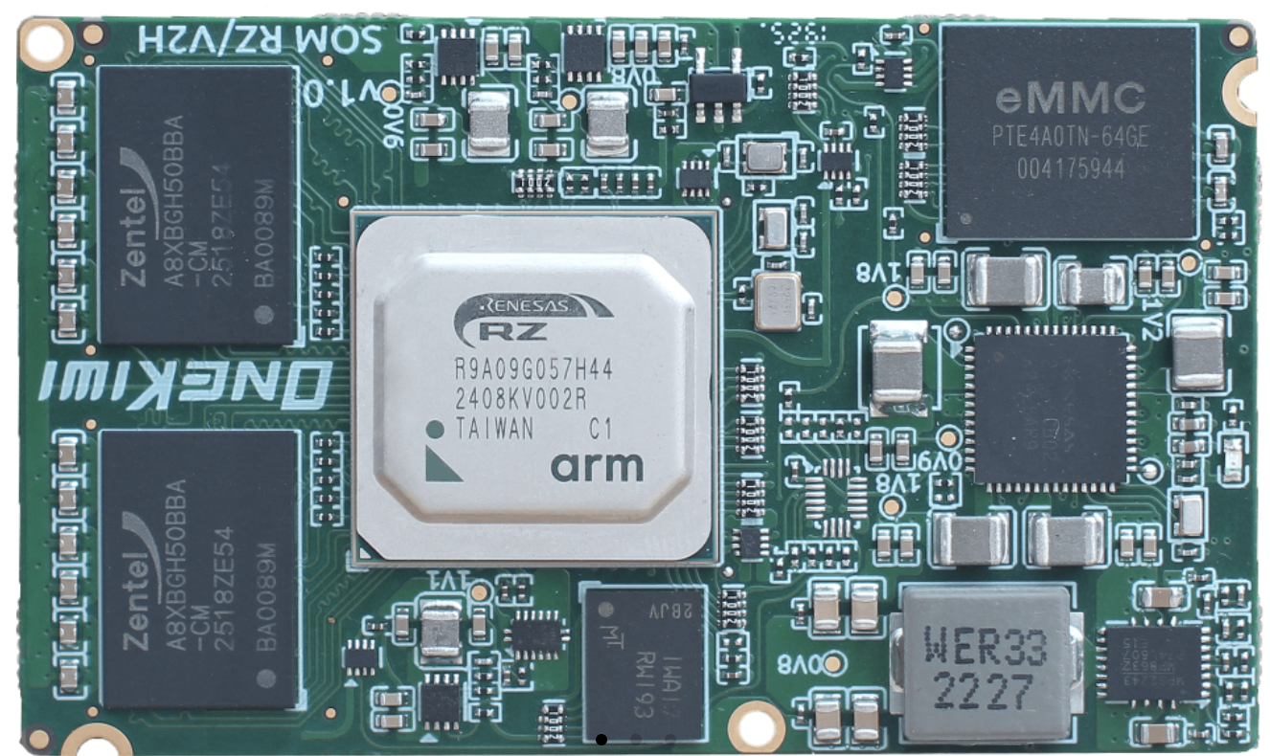

About OneKiwi Company
GowinSemi
Design Partner

Slide 4

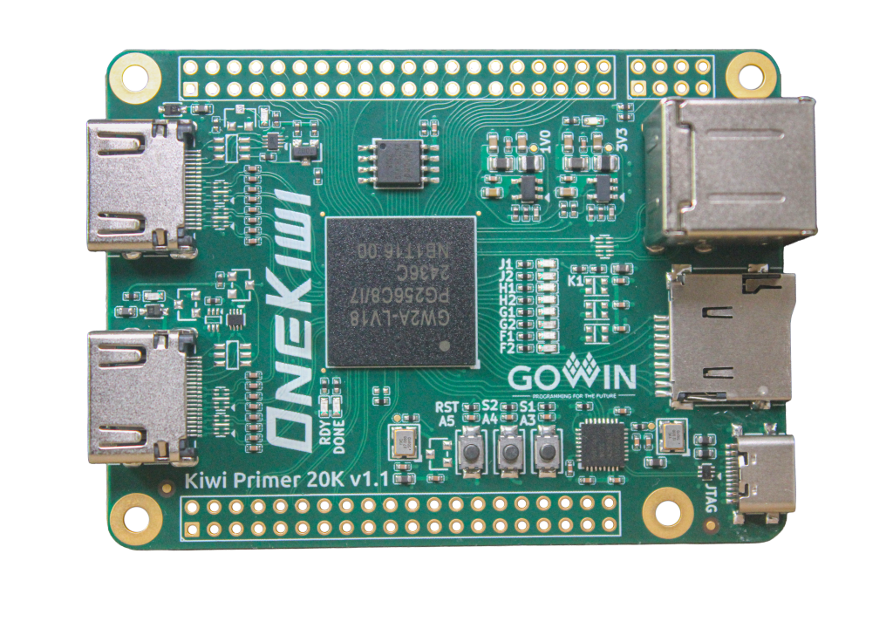
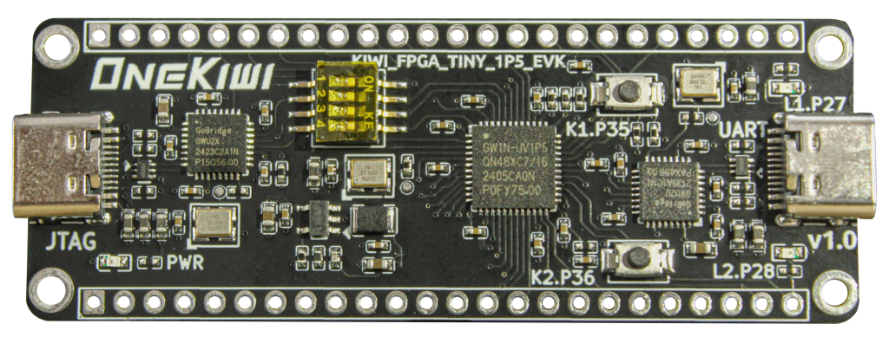
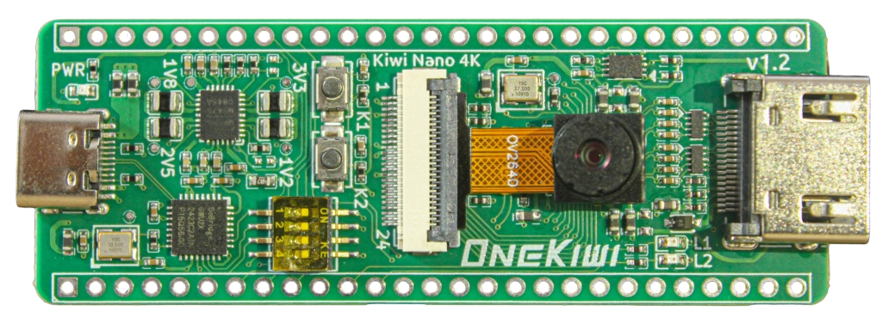
OneKiwi FPGA Boards for Competition
Scalable Gowin-based platforms for students: from basic logic to vision, MCU and multimedia system design
KIWI 1P5
KIWI 4K
KIWI Primer 20K
1,584 LUTs
4,608 LUTs
20,736 LUTs
GW1N-UV1P5
GW1NSR-LV4C + Cortex-M3
GW2A-LV18PG256 + DSP + Softcore MCU
Entry-level FPGA board
Embedded MCU Multimedia board
Advanced FPGA platform
Best for: digital logic, UART/SPI, simple control, IP verification
Best for: camera + HDMI demos, MCU + FPGA co-design
Best for: complex IP, multimedia, microSD + dual USB systems
Competition-ready value
Onboard USB-JTAG simplifies setup | Common Gowin workflow | Projects scale across three difficulty levels | Suitable for education, Industrial control and FPGA IP verification
onekiwi.com.vn

Slide 5
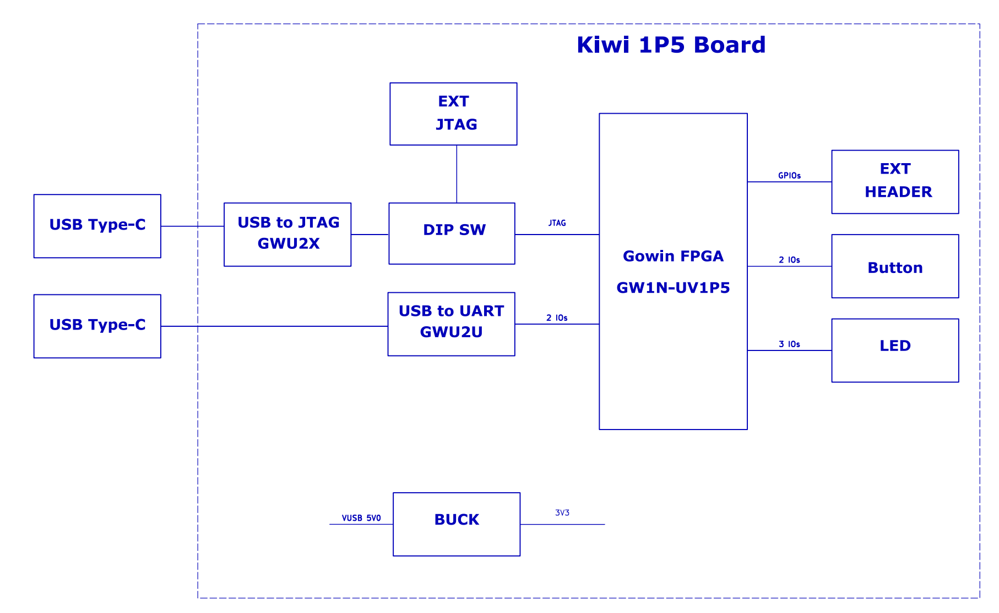
KIWI 1P5 Block Diagram

Slide 6
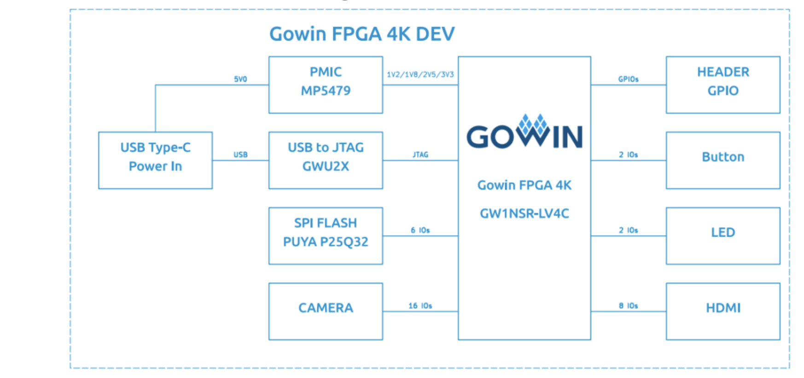
KIWI 4K Block Diagram

Slide 7
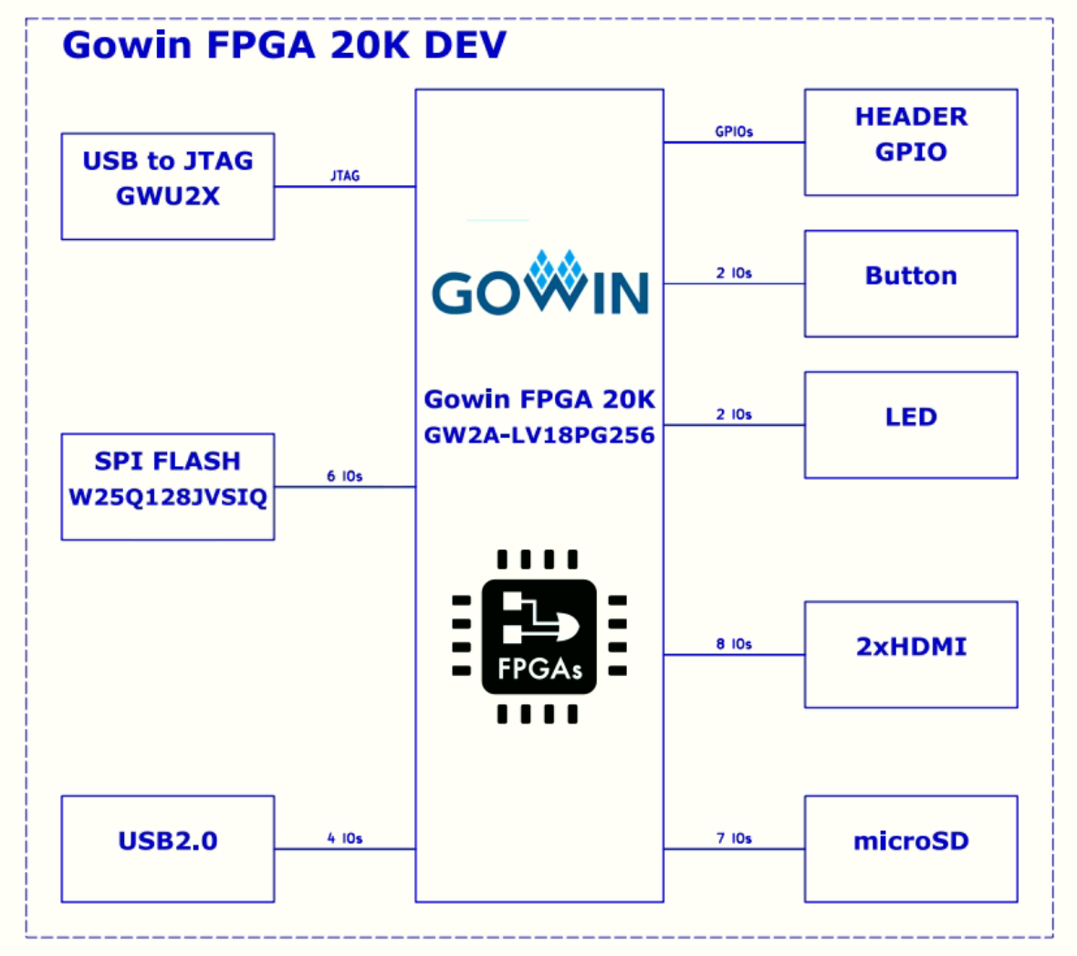
KIWI 20K Block Diagram

Slide 8
THANK YOU
PHU TRUONG
PHUTRUONG@ontech.com.vn
https://onekiwi.com.vn/
Join us in revolutionizing the embedded systems market.

